Slide 1
Introduction of OGC Standard
Ryosuke NAKAMURA
AIST, Japan

Slide 2
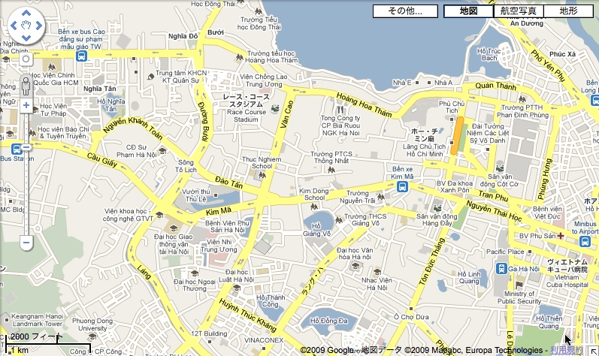
From paper maps to Web-based maps

Slide 3
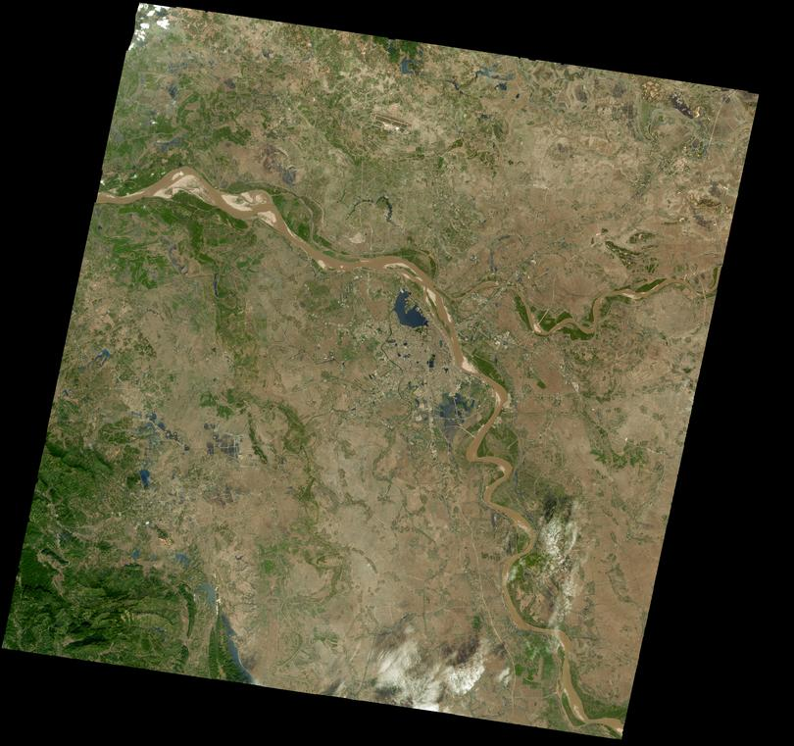
Hanoi on 2000-11-13
observed by ASTER

Slide 4
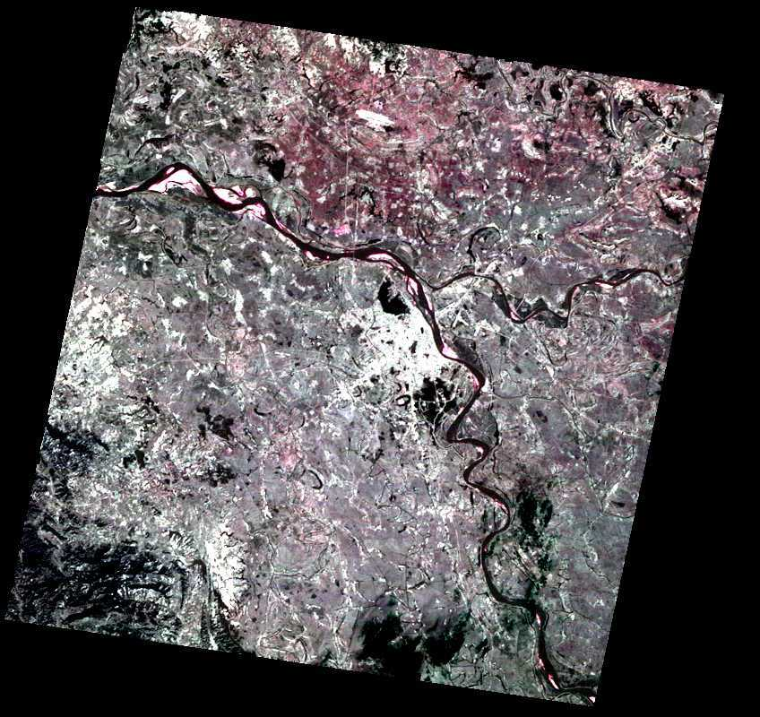
Hanoi in infrared

Slide 5
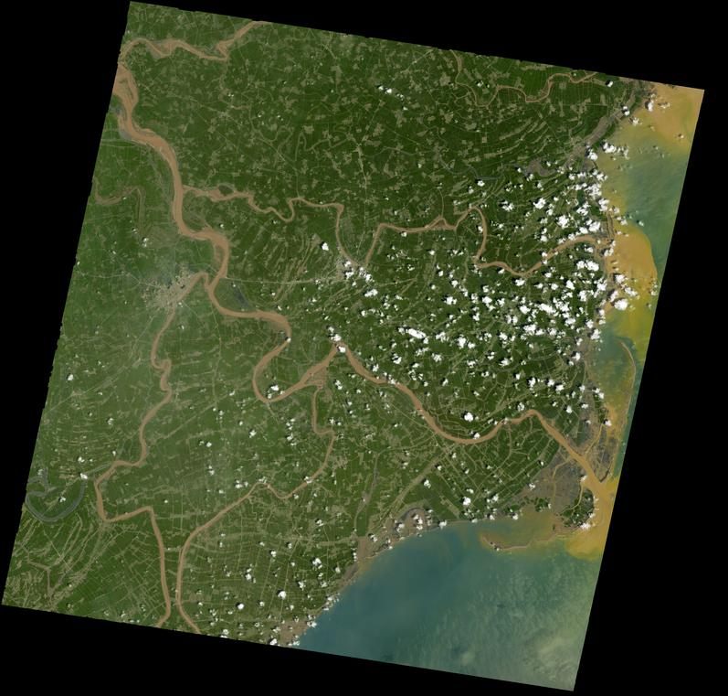
2002-08-31

Slide 6
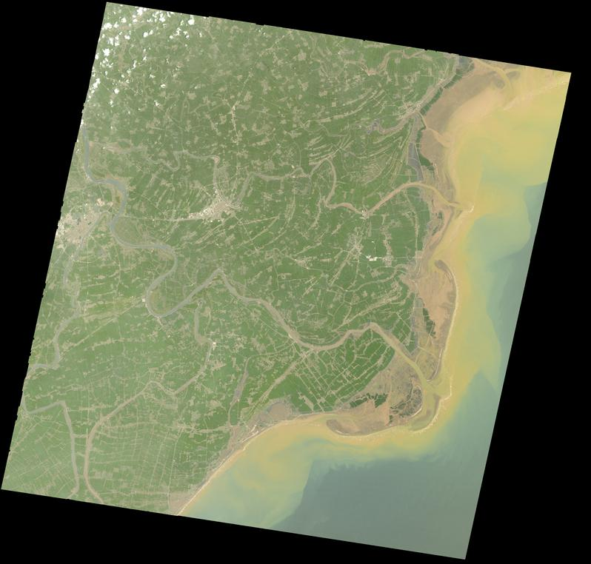
2006-05-06

Slide 7
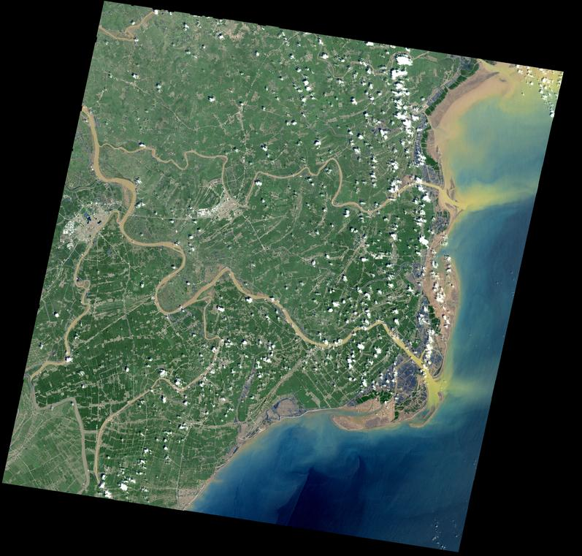
2009-09-19

Slide 8
Possible targets of Web-based Mapping using satellite imagery
Disaster mitigation
Global and national geospatial information infrastructures
Environment monitoring
Urbanization, heat island,,,,,.etc
Map/Images need to have the same coverage, size and
Projection for overlay and GIS-based analysis

Slide 9
Geospatial Interoperability using OGC Web Services
Interoperability
  Freedom to combine and integrate components of an information system
Open Standards
  Exchangeable across different application/platforms
Open Geospatial Consortium (OGC)
  Consortium of GIS vendors, government agencies, academic institutions and private entities
  Proposing standard and specifications for geospatial Interoperability (data format, protcol, definition of map projection, metadata ,,,etc)

Slide 10
Specifications
Catalog Service/WEB (CSW)
Geography Markup Language 3.0 (GML)
Web Map Service (WMS)
Web Feature Service (WFS)
Web Coverage Service (WCS)
Style Layer Descriptor 1.0 (SLD)

Slide 11
http://geodata1.geogrid.org/mapserv/g2000k/g2000ke?service=WMS&REQUEST=GetCapabilities
<?xml version='1.0' encoding="EUC-JP" standalone="no" ?>
,,,,
<!DOCTYPE WMT_MS_Capabilities SYSTEM http://schemas.opengis.net/wms/1.1.1/WMS_MS_Capabilities.dtd
<Service>
<Name>OGC:WMS</Name>
<Title>1/2,000,000 geological map asia (English)</Title>
<OnlineResource xmlns:xlink="http://www.w3.org/1999/xlink" xlink:href="http://geodata1.geogrid.org/mapserv/g2000k/g2000ke?"/>
</Service>
,,,
<Layer>
<Name>g2000ke</Name>
<Title>1/2,000,000 geological map asia (English)</Title>
<SRS>esri:54004</SRS>
<SRS>epsg:4326</SRS>
<SRS>epsg:4612</SRS>
<SRS>epsg:4301</SRS>
<LatLonBoundingBox minx="92.1903" miny="-16.6333" maxx="155.955" maxy="47.6128" />
<BoundingBox SRS="EPSG:4612"
minx="92.1903" miny="-16.6333" maxx="155.955" maxy="47.6128" />
<Layer queryable=“0” opaque=“0” cascaded=“0”>
,,,,,
</Capability>
</WMT_MS_Capabilities>
WMS - getCapabilties

Slide 12
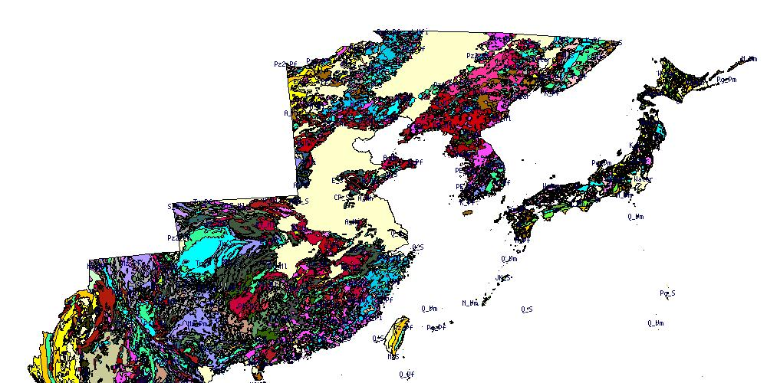
WMS - getMap
http://geodata1.geogrid.org/mapserv/g2000k/g2000ke?service=WMS&VERSION=1.1.1&REQUEST=GetMap&layers=g2000ke&srs=EPSG4326&width=1000&height=500&bbox=90,20,150,50&format=image/jpeg

Slide 13
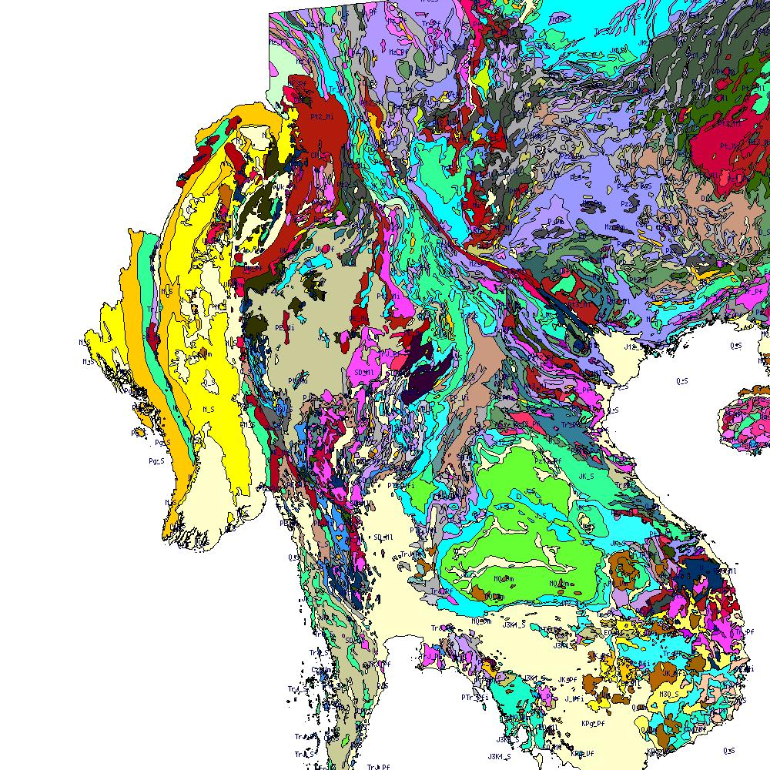
http://geodata1.geogrid.org/mapserv/g2000k/g2000ke?service=WMS&VERSION=1.1.1&REQUEST=GetMap&layers=g2000ke&srs=EPSG4326&width=1000&height=1000&bbox=90,10,110,30&format=image/jpeg

Slide 14
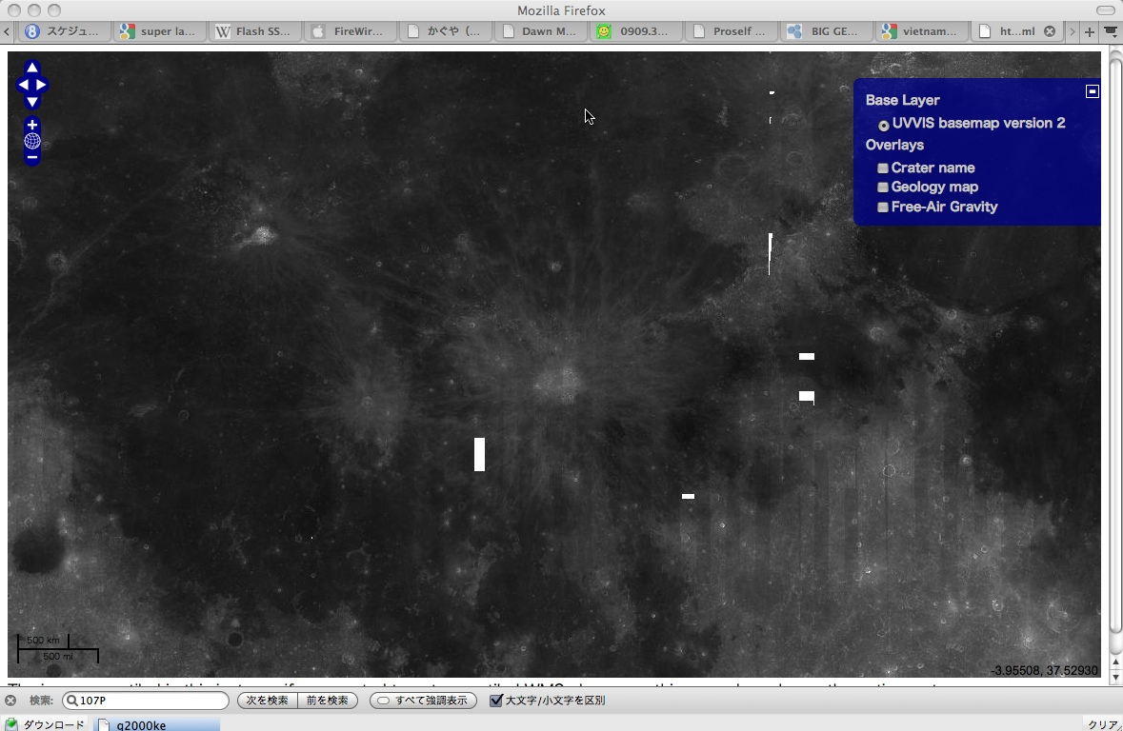
An example of the overlay based on WMS

Slide 15
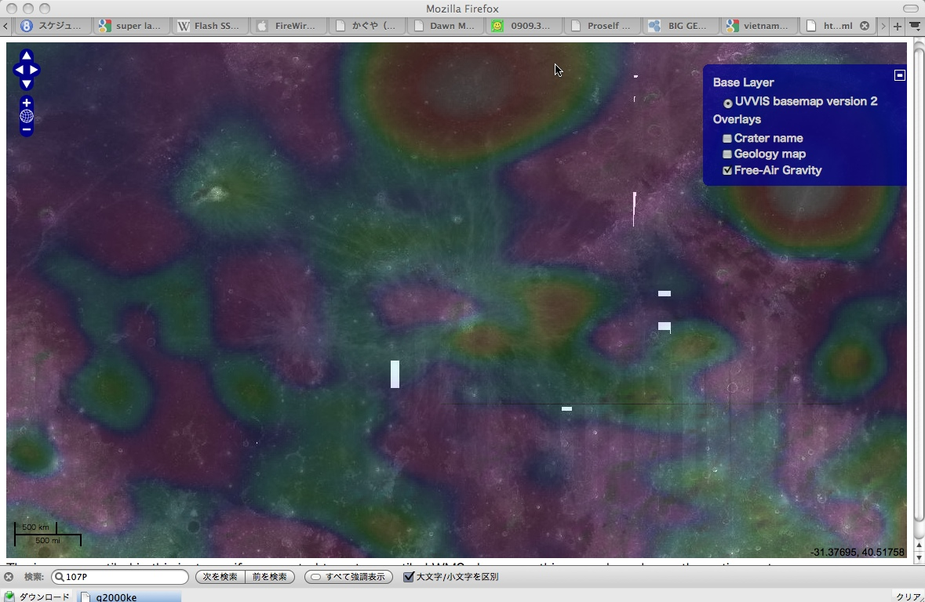

Slide 16
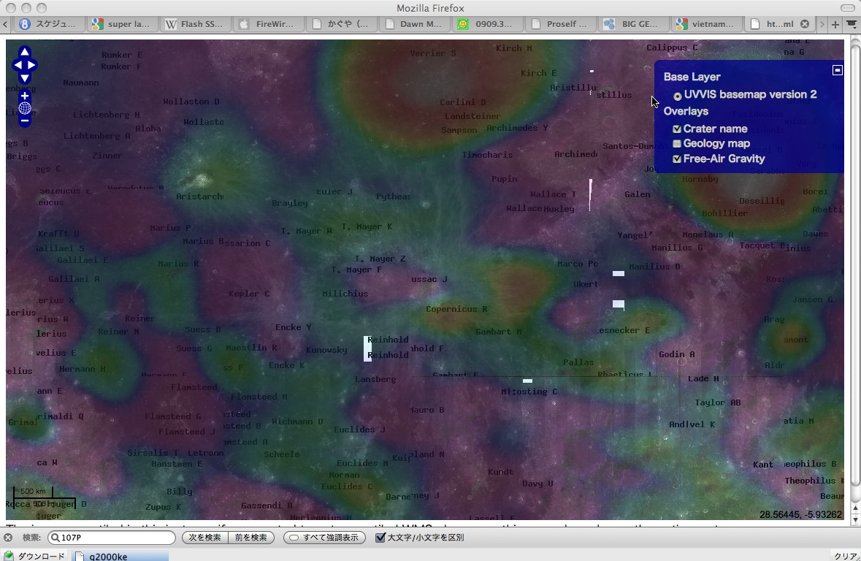

Slide 17
OGC and FOSS4G
Free and Open Source Software (FOSS) for Geoinformatics (FOSS4G)
  Alternative approach for software development
Many implementations are available and active communitiy
  MapServer (WMS, WFS, WCS)
  52 North (SOS)
  GeoServer (WMS,WFS,WCS)
  GLASS, pyWPS (WPS)
  OpenLayers (UI) ,,,,,,etc

